Slide 1

Team 1: Hong Gyu Ju, Shuning Wang , Jasper Qiu, Javier Lasa, Viktor Nisnevich, Olatoyosi Fatoki

Slide 2

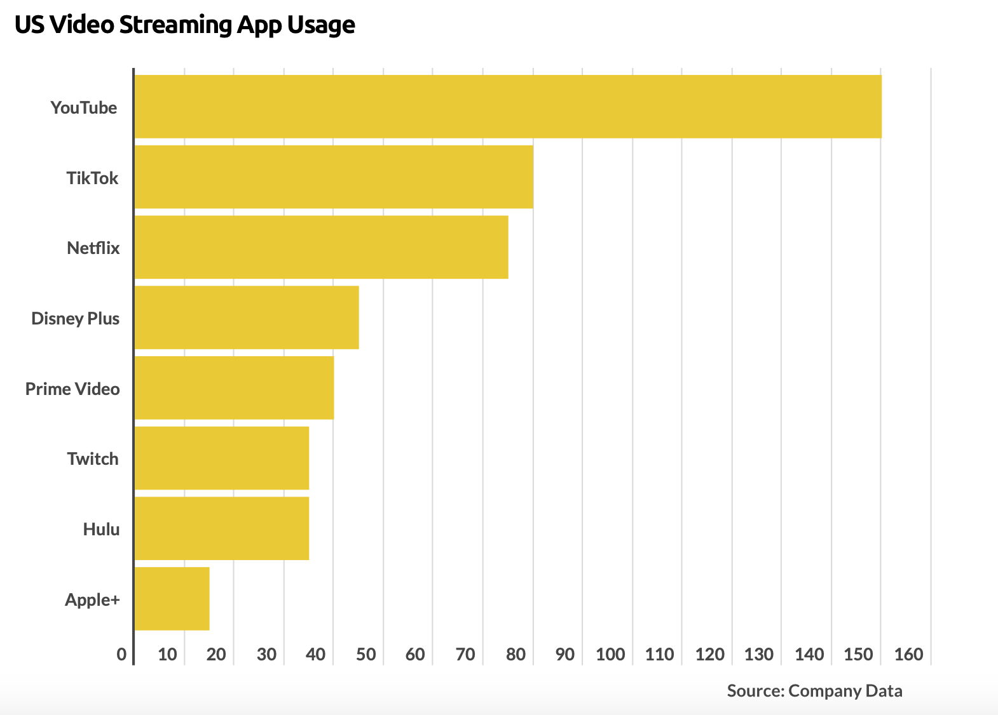
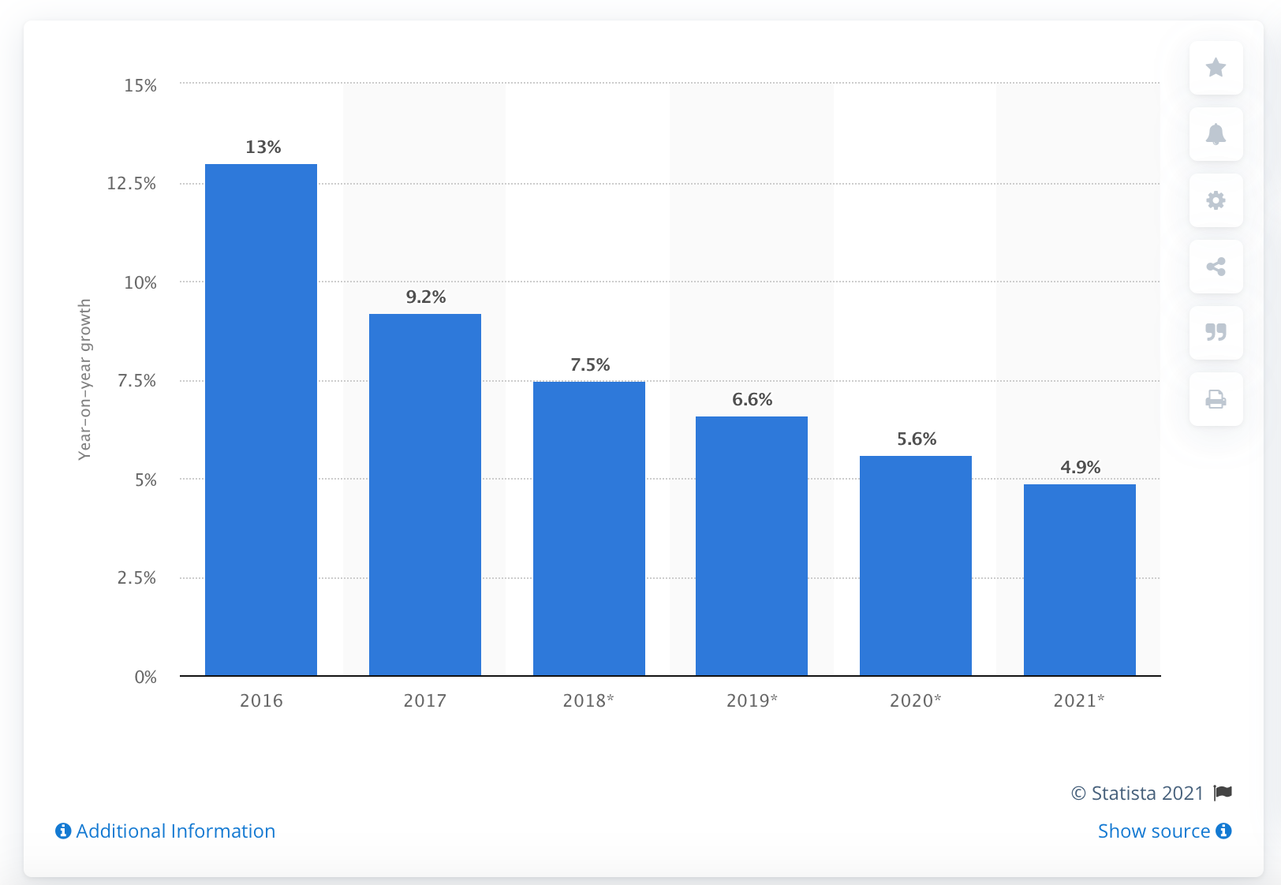
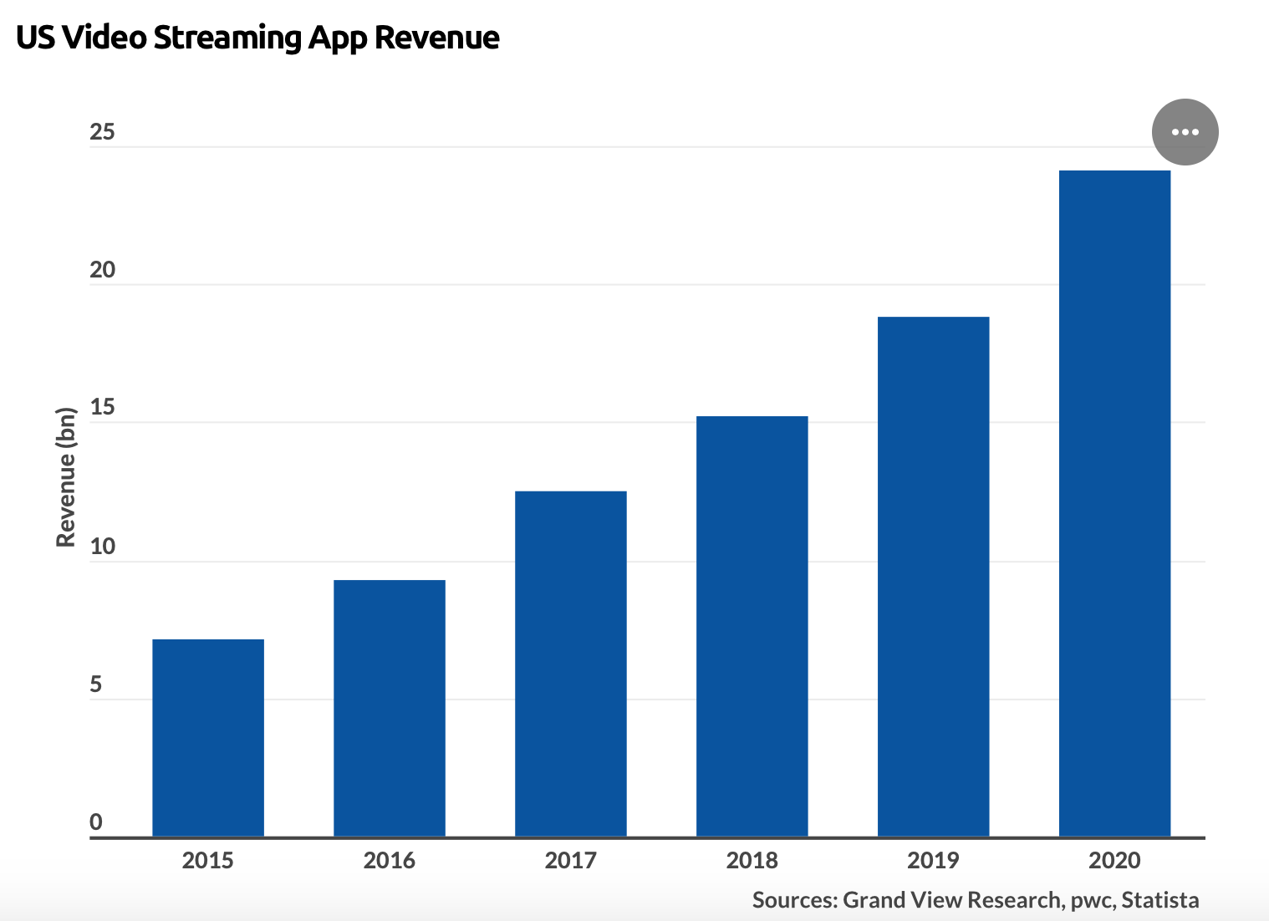
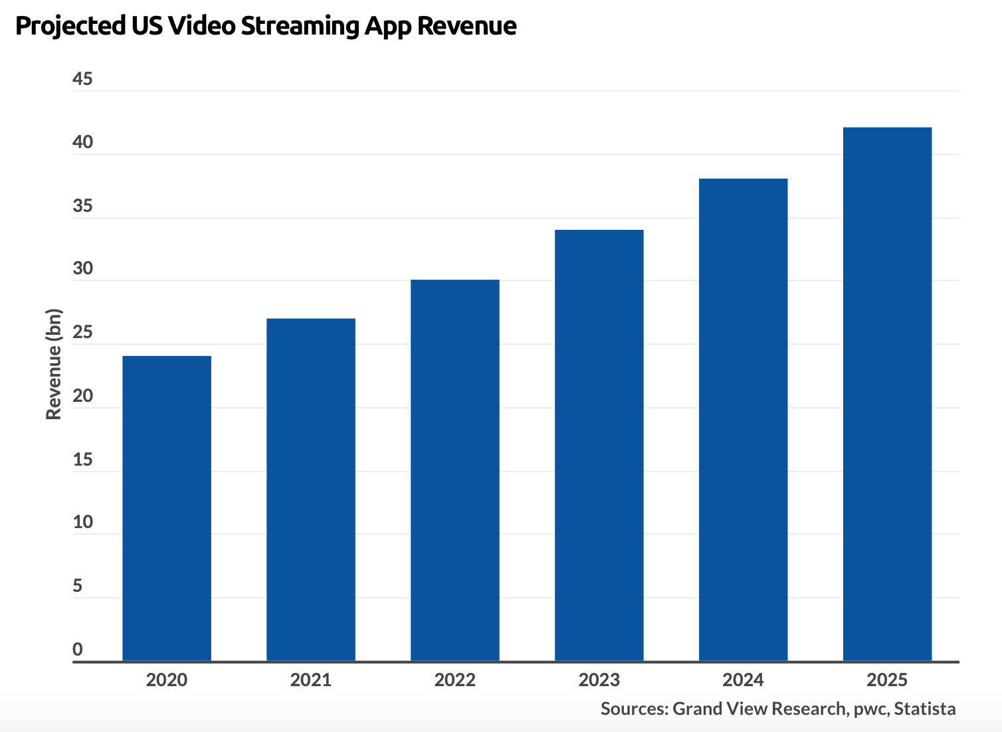
Video streaming: Present and Future

Slide 3
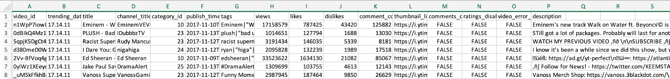
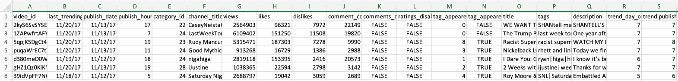
Sample of Original Data - 5 Datasets
Trending YouTube Video Statistics:
> The trending data has 23 columns including video_id, trending_date, and comments
YouTube Trending Video Statistics with Subscriber:
> The subscriber data has 20 tables of scribers from different countries like United States, France, and Russia. For each table, it has 16 columns recording the detailed information of users and subscribed video
Except the two major data source, our team also used the YouTube Video and Channel Metadata, Top 500 most subscribed YouTube channels in the last 30 days, YouTube Top artists to add the entities of artist, views, and like/dislike

Slide 4


Normalization
1NF: To ensure no muti-valued fields and each table has a unique identifier.
2NF: To make sure every non-prime attribute is dependent exclusively on the primary key
3NF: Attributes are determined only by the primary key.
Rank
Username
Rank | Grade | Username
Username | Subs | Uploads | Video_views
Channel
channelid | Videoid | videocount | likes_views | totalviews_channelelapsedtime | Subscribercount | Channelcommentcount | views_subscribers | likes_subscriber | Dislikes_subscriber | comments_subscriber | Totviews_totsubs | Views_elapsedtime | dislikes_views | Comments_views | totvideos_videocount | Channelviewcount
Artists
Channel_video
Artist | Total | 100M | Avg
Videoid | videocategoryid | Videopublished | Videocommentcount | Videoviewcount | Videodislikecount | Videolikecount | Likes_dislikes | Elapsedtime

Slide 5
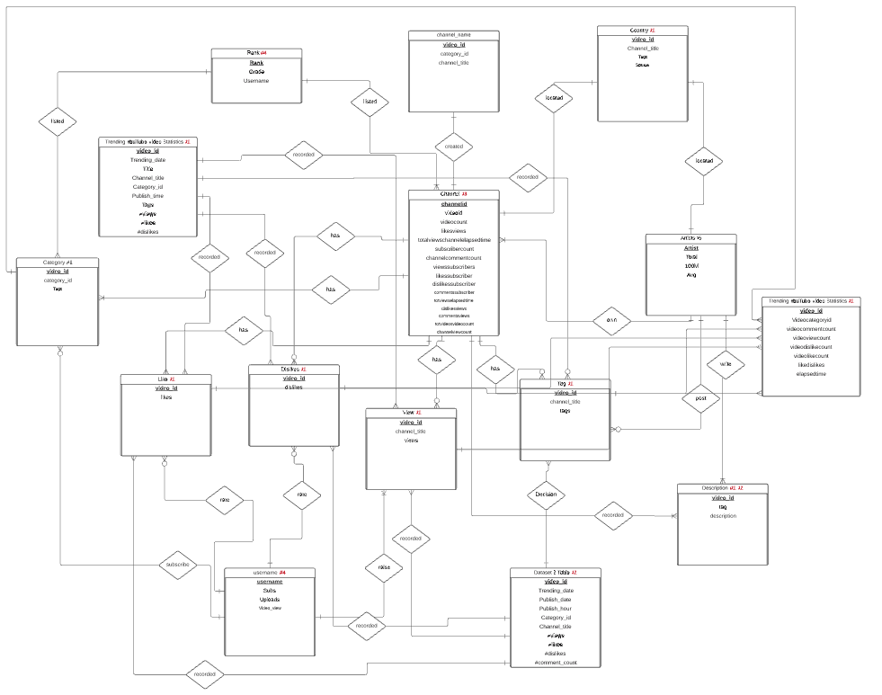
Normalization

Slide 6
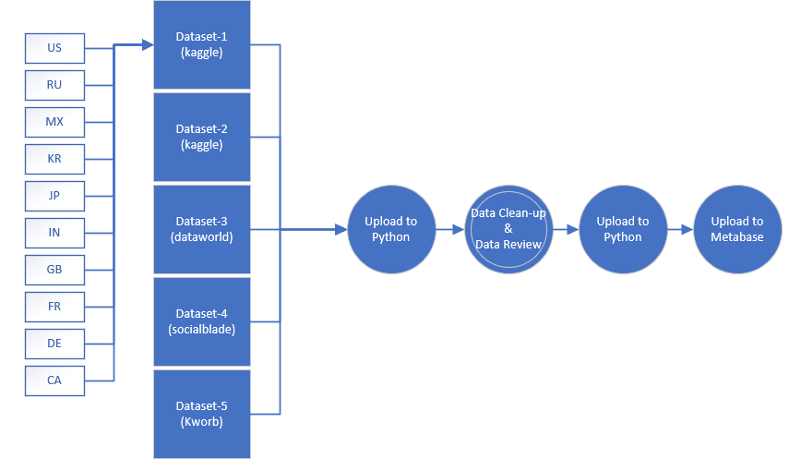
ETL Pipeline
The ETL pipeline of our project is as follows:
Extract
Collect 5 datasets from different sources
kaggle, dataworld, socialblade, kworb
Transform
Upload CSV/JSON files to python for review
Check the data types / review for null or missing values
Add new columns and unique Identifiers if necessary
Merge files into master table
Clean the data in master table
data imputation, data type conversion, data formatting
Create 15 tables based on 3NF layout
Load
Load to Database Schema
Connect to Metabase BI Tool for data visualization

Slide 7
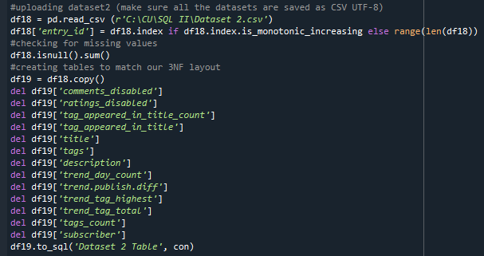
Process of interacting with data
As a consulting group, our goal was to develop a dashboard view for YouTube’s senior leadership that will showcase to them their users’ interaction patterns from various data sources. This will enable YouTube’s analytics/marketing teams to appropriately match video content creators with the right advertising agencies to boost ad revenue.
Our first step was to upload all of the datasets into Python for data clean up, review and analysis:

Slide 8
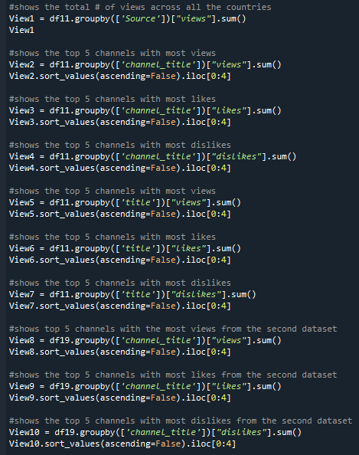
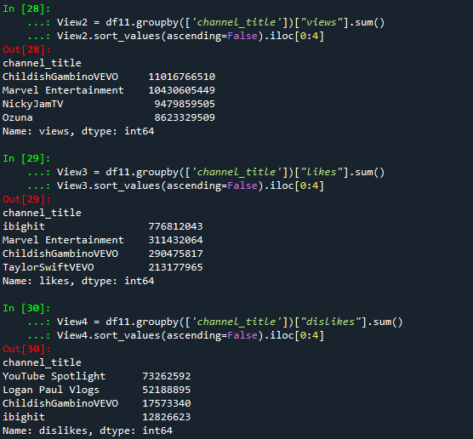
Data Analysis
Once all the datasets were broken down and uploaded into pgAdmin as per our 3NF distribution, we focused on analyzing the data to gain valuable insights prior to customizing dashboards for our audience. We focused our analysis on top 5 successful channels across key attributes such as Total Views, Likes, Dislikes, Video uploads and other user interaction metrics:

Slide 9
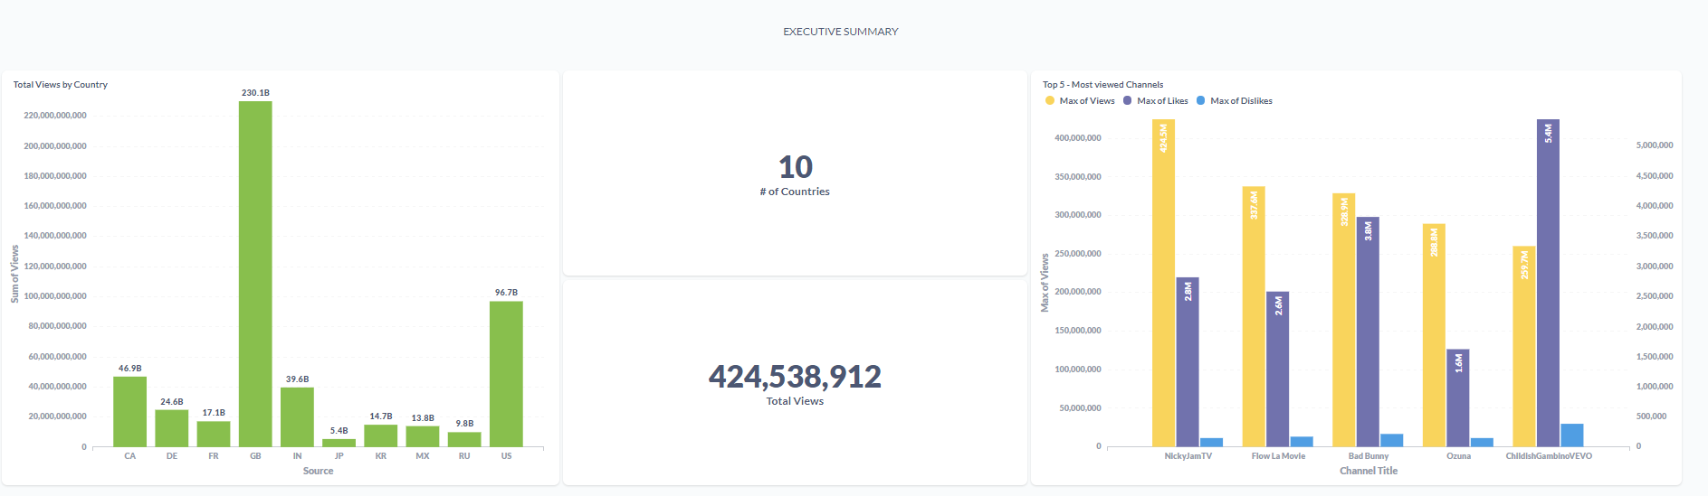
Metabase DEMO
Once all the data was analyzed, we built 2 custom made dashboard views in Metabase:
1st view was for Senior leadership to give them a general overview of Youtube interactions across 10 different countries
2nd view was for their Analytics Team to gain detailed insights of the YouTube content creators of their choice
http://localhost:3000/dashboard/3

Slide 10

Q&A

